Slide 1
PA State Budget: FY 2011-12
Notes:
This is a graphical view of our project ECRs broken down by employer normal cost, the annual cost of new benefits earned, healthcare, small yellow line and the unfunded liability.
Normal cost is in blue and as you can see it declines over time as the impact of Act 120 kicks in FY 2013/2014 and decreases the employer cost each year.
The big elephant in the room is the unfunded liability in red. Act 120 provided a more gradual increase in ECRs but the bottom line is that rates will need to go up to adequately fund the pension system.
See next slide.

Slide 2
PSERS Plan Deductions

Slide 3
Expected Benefit Payments

Slide 4
PSERS Funding by Source

Slide 5
PSERS Membership
Fiscal Year Ending | Active Members | Inactive Members | Annuitants, Beneficiaries, and Survivor Annuitants | Total Active/Retired Members | Ratio of Active/Retired | Total Inactive, Active & Survivor Annuitants
2011 | 279,152 | 115,102 | 194,622 | 473,774 | 1.43 to 1 | 588,876
2010 | 282,041 | 111,931 | 184,934 | 466,975 | 1.53 | 578,906
2009 | 279,701 | 103,805 | 177,963 | 457,664 | 1.57 | 561,469
2008 | 272,690 | 100,803 | 173,540 | 446,230 | 1.57 | 547,033
2007 | 264,023 | 109,186 | 168,026 | 432,049 | 1.57 | 541,235
2006 | 263,350 | 94,071 | 161,813 | 425,163 | 1.62 | 519,234
2005 | 255,465 | 58,720 | 156,519 | 411,984 | 1.63 | 470,704
2004 | 247,901 | 72,014 | 151,552 | 399,453 | 1.63 | 471,467
2003 | 246,700 | 65,453 | 145,693 | 392,393 | 1.69 | 457,846
2002 | 242,616 | 61,295 | 141,414 | 384,030 | 1.71 | 445,325

Slide 6
PSERS Contribution (By Year)
In thousands (000)

Slide 7

PA State Budget: FY 2011-12
Budget Challenges
Spending Outpaced Inflation
www.PABUDGET.com

Slide 8
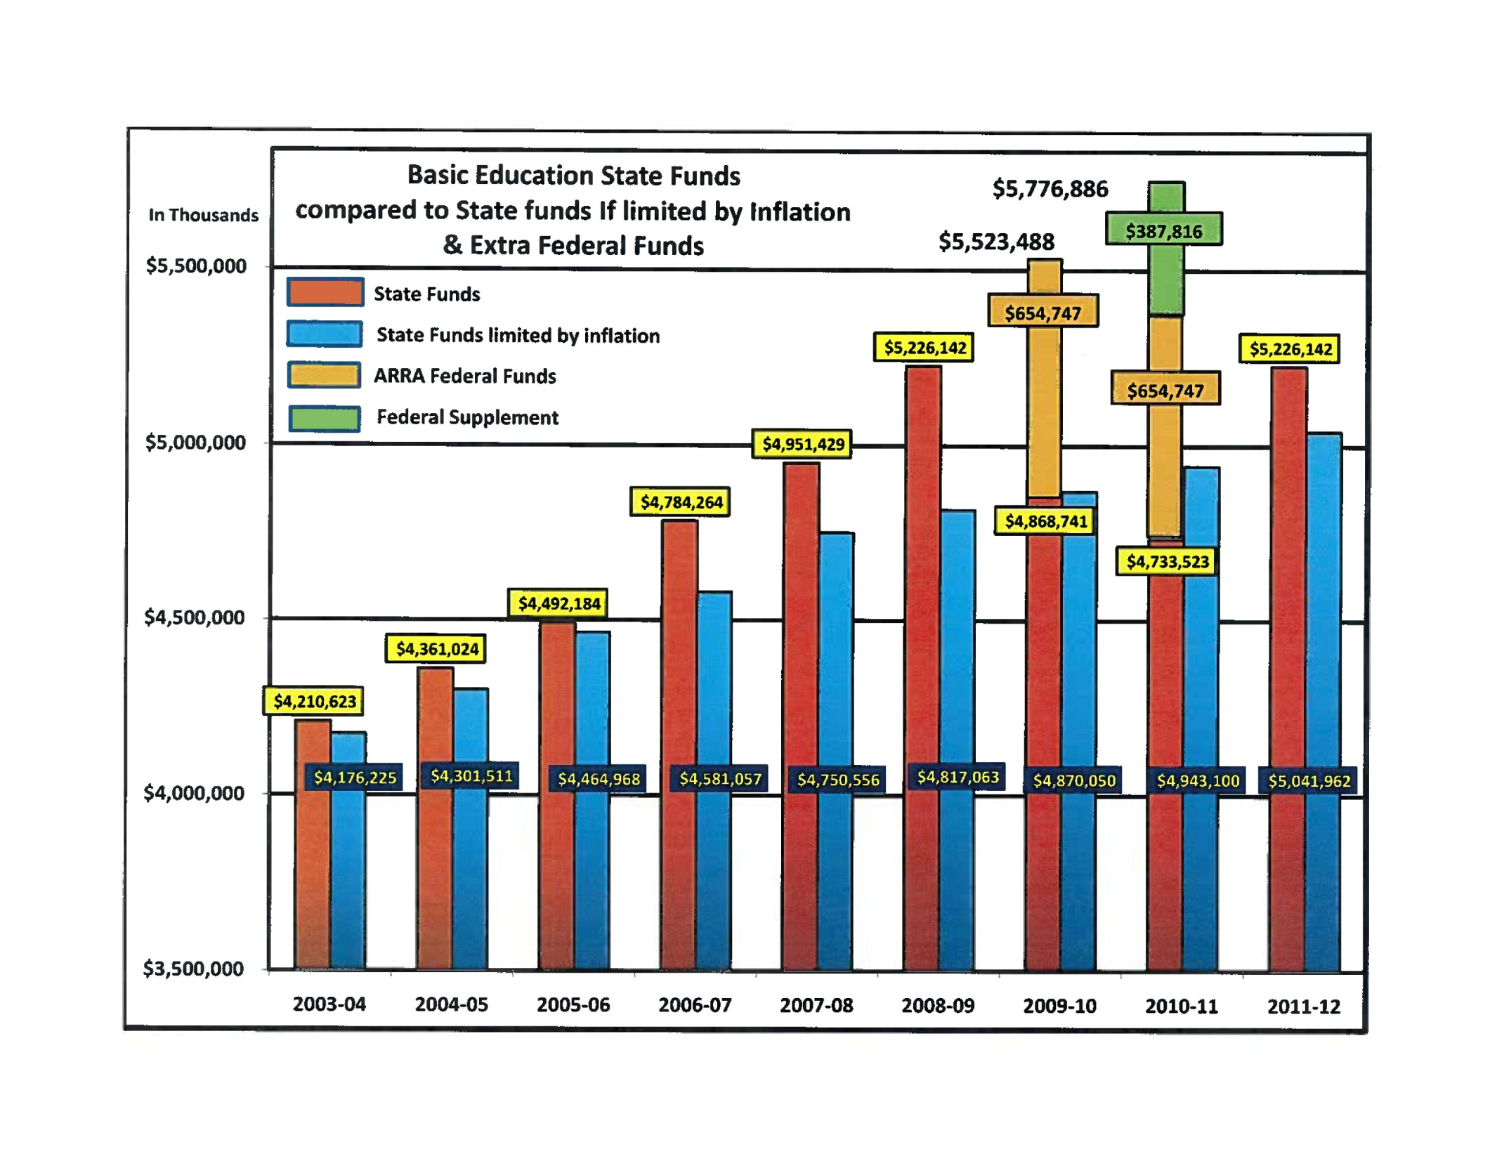
PA Education Funding

Slide 9
PA Case Law
Case
The Association of Pennsylvania State Colleges and University Faculties, et al.
v. The State System of Higher Education, et al.
Court
Supreme Court of Pennsylvania May 15,1984

Slide 10
Constitutional Constraints
The Constitution of the United States of America– Article One, Section Ten
“No State shall enter into any Treaty, Alliance or Confederation; grant letters of Marquee and Reprisal; coin Money; emit Bills of Credit; make any Thing but gold and silver Coin a Tender in payment of Debts; pass any Bill of Attainder, ex post facto Law, or Law impairing the Obligation of Contracts, or grant any Title of Nobility.”
The Constitution of the Commonwealth – Article One, Section Seventeen:
“No ex post facto law, nor any law impairing the obligation of contracts, or making irrevocable any grant of special privileges or immunities, shall be passed.”

Slide 11
PA Case Law: The Ruling
“And it is the law of this Commonwealth that unilateral modifications in the retirement system, after retirement eligibility requirements have been met, may not be adverse to the member.”
“It is clear that section 7 must fall under either standard advanced in Catania. The record simply does not support the Commonwealth’s contention that section 7 enhances the soundness of the Fund by definition. The Stipulations of the parties establishes that section 7 merely shifts some of the financial burden of contributions from the employer to the employees. Moreover, Act 31 contains no offsetting advantages to the members of the System. Thus, under the view expressed in the Opinion in Support of Denial of Summary Judgment filed in Catania, section 7 is an unconstitutional impairment of contract.”

Slide 12
PA State Budget: FY 2011-12
General Fund Spending: $27.15 Billion
www.PABUDGET.com

Slide 13
Public School Overview
Revenue, Enrollment, Employees
Revenue: $26B
Revenue: $26B
Revenue: $13.5B
Revenue: $13.5B

Slide 14
States Rank, Burden on Businesses
States with Highest Tax Burden & Why
New Jersey
New York
Indiana
Massachusetts
Illinois
Rhode Island
Kansas
West Virginia
Hawaii
Pennsylvania
High tax rates (CNIT, sales, UI, property)
High sales tax rates on equipment and inventory
Few or Lack of incentives
Subject high percentage of income to state CNIT
State-specific taxes stifle competitiveness
Source: Tax Foundation 2012 Location Matters Study.

Slide 15
TESD Salary Data (as reported to PSERS)
In thousands (000)

Slide 16
Staffing, PSERS Contributions FY 2011-2012
Staffing at Local Schools
PSERS Contribution
Number
Dollars

Slide 17
Senate Memo From June 2, 2009
To Superintendents and School Boards
Alerted schools of coming budget shortfalls
Advised schools to “hold line on spending” to avoid local tax increases
Asked schools to “look for ways to cut spending”
Reiterated Federal Government warning against using ARRA or stimulus funding for education
Warned of “funding cliff” scenario that federal government expressly cautioned against

Slide 18
Other Warning Signs
From a December 2007 release from PSERS:
Told schools to prepare so as “to avoid the dramatic contribution rate increase forecast in less than five years.”
From Department of Education guidance given in 2007:
“The Department of Education recommends that school districts plan accordingly by budgeting based on a 7.13% employer contribution rate.”
Communication from PSERS Executive Director Jeffrey Clay, 2010
“I urge you to consider adding the additional funds you may have budgeted this year to your reserve accounts since the pension funding issue remains and the rate spike is fast approaching.”
(FYI – mandated rate was lowered to 5.64% from previous rate of 8.22%)

Slide 19
FUND BALANCE
JUNE 2009, 2010, 2011
Unreserved Fund Balance – June 30, 2009
Designated for future retirement plan rate stabilization $ 4,505,380
Unreserved Fund Balance – June 30, 2010
Designated for future retirement plan rate stabilization $ 10,533,472
Unreserved Fund Balance – June 30, 2011
Designated for future retirement plan rate stabilization $ 15,350,606

